Slide 1


facebook EDA
PROJECT
Analysis
Attributes
Objective
About
Report with findings and recommendations
Submitted By VINOD RAWAT
Notes:
Hello Everyone, Hope you all are safe and doing well !! I am Vinod Rawat and Today we are here to discuss Exploratory Data Analysis Findings and Recommendations of the facebook Project.

Slide 2
Facebook user data
To identify facebook usage patterns
Analysis
Attributes
Objective
About
Understand Target User Market & build Strategies
Notes:
A brief about the Project:
Facebook user data can have lots of insights based on user Age, Gender, Tenure on facebook, different Activities done and different platform used by them to access Facebook.
Problem Statement is to understand Facebook users in detail by identifying different patterns in facebook user dataset
Target is to find hidden patterns in facebook users dataset to understand users and build right strategies accordingly to optimize product, services and maximize revenue.

Slide 3



Correct Recommendations based on Insights
Analysis
Attributes
Objective
About
User
Demographics
Platform
Identify facebook user usage pattern
across gender
Identify facebook user demographics through their different age groups
Identify different platform used for facebook and most preferred one.
Notes:
Moving on to the Objective of this Project.
Focus of the analysis is on 3 main subjects:
First- the User Analysis where the focus is on identifying facebook user pattern across gender
Second – the Demographics basis users age, different age groups.
And Finally the Platform– where focus is on identifying the most used platform by users for facebook use.

Slide 4





99 K
Age
Gender
Tenure
Friend count
Mobile & Web
User
Demographic
Activity
Platform
Tenure
Likes
Friendship Initiated
User DOB
1
2
3
4
5
Based on
Based on
Based on
Based on
Based on
Analysis
Attributes
About
Gender,
Friends count Friend request
Age groups,
Friends, Friends request across gender
Friends request & Likes across gender and age groups
Mobile & Web usage
Across gender and age groups
Days/Years spend by users and different age groups
Facebook users belong to every age from 13 to 113.
No major correlation among dataset variables except one.
Friend count has strong correlation with friendship initiated.
Notes:
Now let’s have a look at the attributes of facebook dataset.
The dataset used for this project has a sample of 99 thousand users and have details like Age, Gender, Tenure, Friend Count, Mobile and Web likes.
The dataset also has details of Likes, Friendship Initiated and User DOB
Initial analysis reveals that facebook users belongs to every age from Age 13 to 113.
There is No Major correlation seen between dataset variables, except one and thats the
Friend count which has strong correlation with friendship initiated.
Hence basis this initial analysis following 5 areas are shortlisted for detailed analysis
First - User Analysis is done basis Gender, Friend Count and Friend Request
Second - Demographic Analysis is done basis Age groups, friends, Friend request across gender
Third - Activity analysis is done basis Friend request & likes across Gender and Age groups
Fourth - Platform analysis is done basis Mobile and Web usage across Gender and Age groups.
And Finally - Tenure analysis is done basis days/year spend by Facebook users and different age groups.

Slide 5
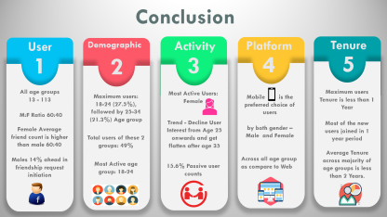
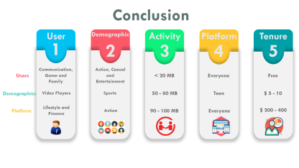
Demographic
User
Activity
Analysis
Attributes
About
Platform
Tenure
Notes:
Now moving on to the detailed analysis of each of these areas, Let’s First discuss the analysis of Users

Slide 6


Slide 7
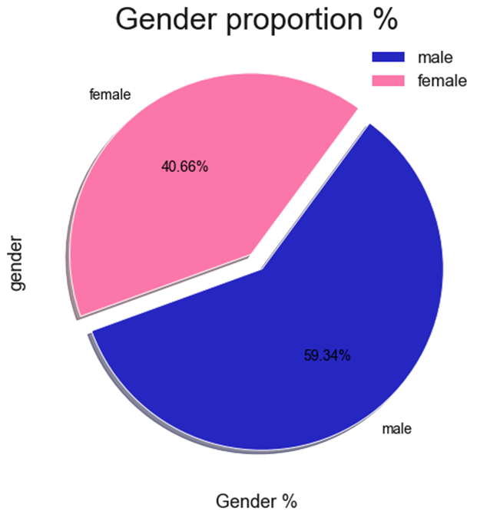
Notes:
As per Gender proportion analysis, Male users are 60% and Female users are 40% in dataset

Slide 8
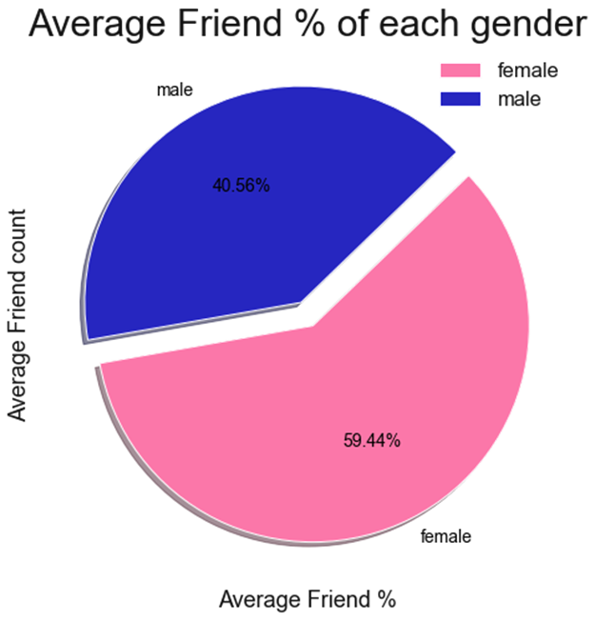
Notes:
But deeper analysis on Average Friend count interestingly reveals that female friend % is 60% and male friend % is 40%.

Slide 9
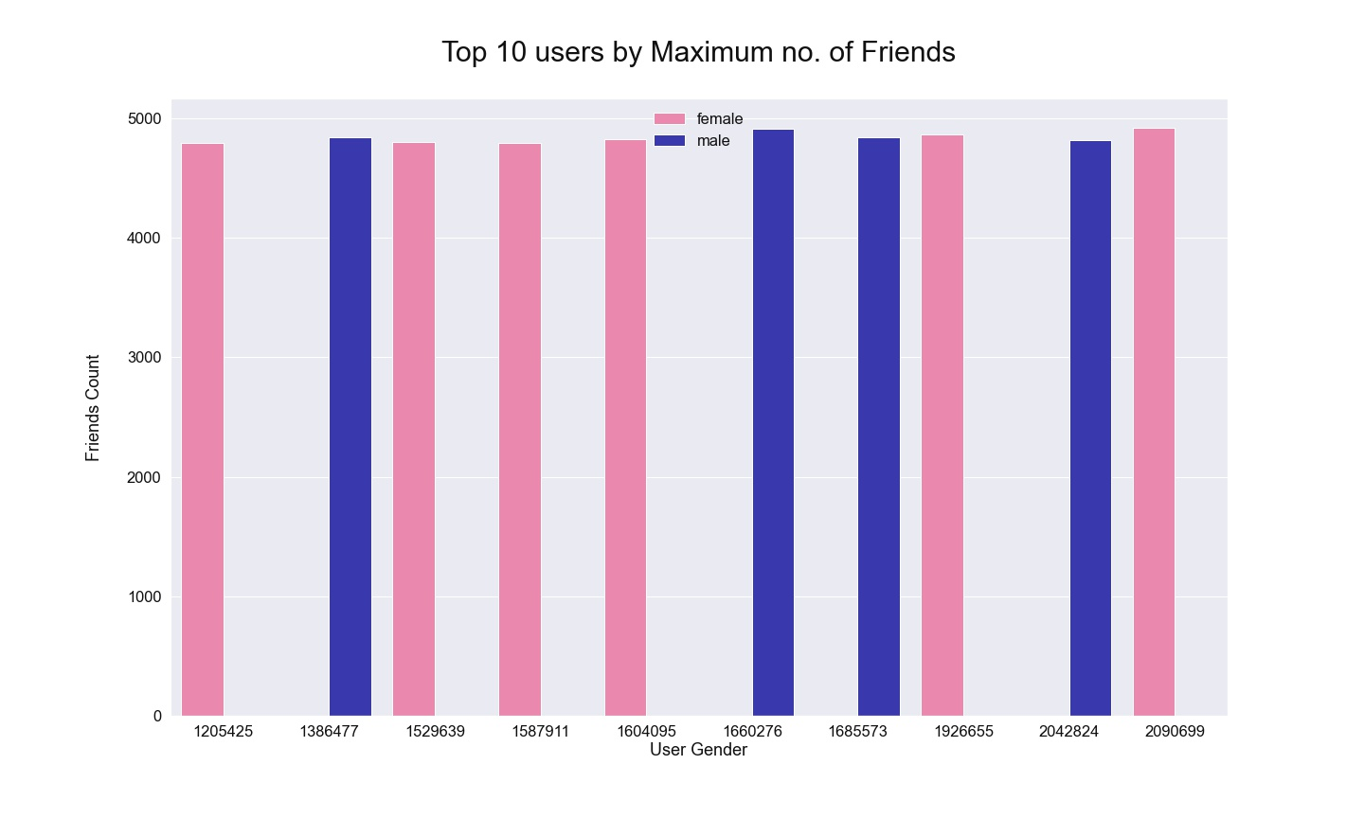


6
4
Notes:
In Top 10 users by maximum no. of friend’s analysis reveals both male and female are having the similar friend count but in top 10, 6 are female and 4 are male.

Slide 10
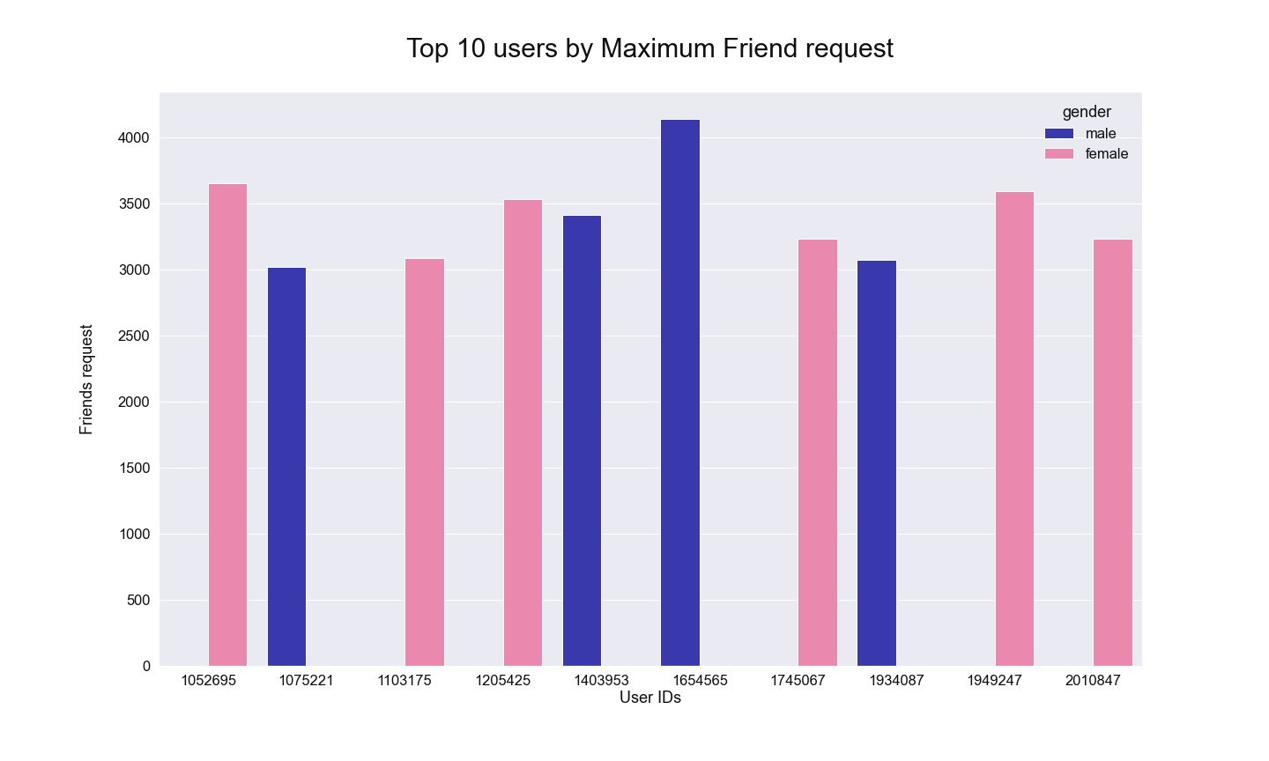
6
4
Notes:
Top 10 users by Maximum Friend request analysis reveals that male user have sent the highest friend request but again females are leading the top 10 with 60:40 ratio.

Slide 11
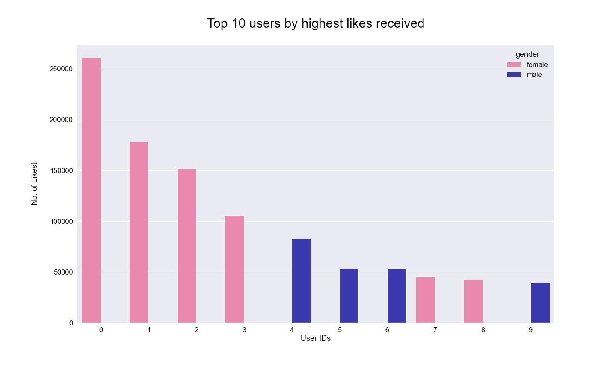
6
4
Notes:
Then Top 10 users by highest likes received analysis reveals that female user is leading the highest likes received count and again females are leading Top 10 with 60:40 ratio.

Slide 12
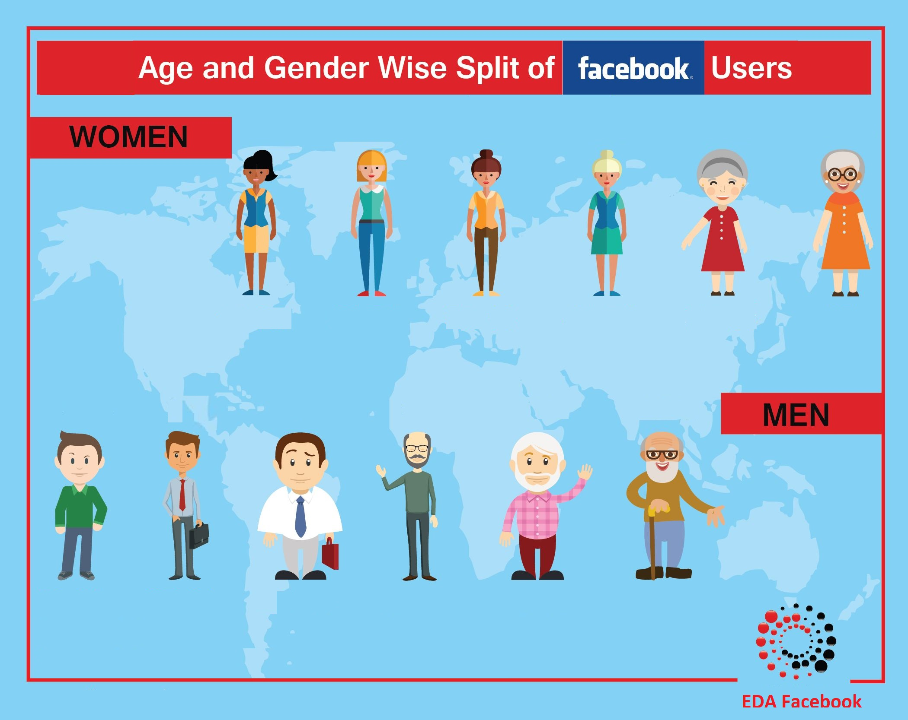

Slide 13
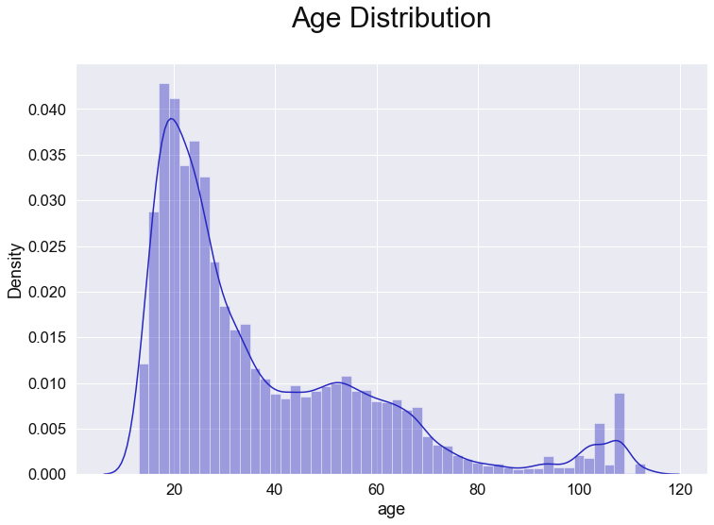
50%
Below Age 28
Notes:
Age distribution Analysis reveals that Age distribution is not normal in this dataset as there are different peeks
Highest peek is around 20's and maximum concentration around 18 to 24 Age.
Average age is 37 years and 50% of users are below age 28.

Slide 14
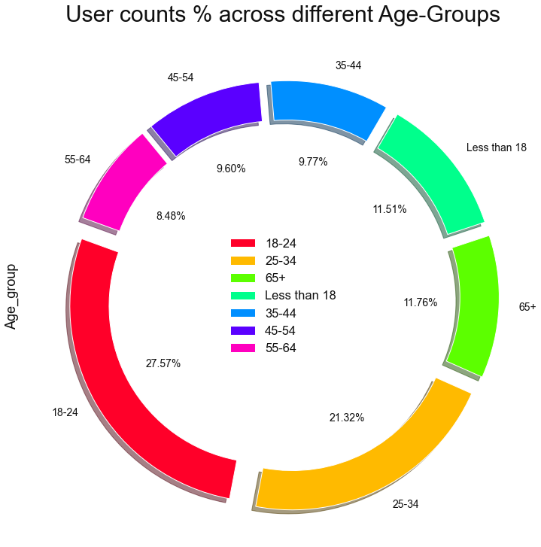
49% users
18-24
25-34
Notes:
Here Age group analysis reveals the interesting insights
Analysis of user count % across different age groups reveals that Maximum users on Facebook are 18-24 age group, that’s around 28%, followed by age group 25-34 with 21% and collective % of these 2 groups is around 49%. And if we add less than 18 user % then 60% user belongs to these 3 age groups.

Slide 15
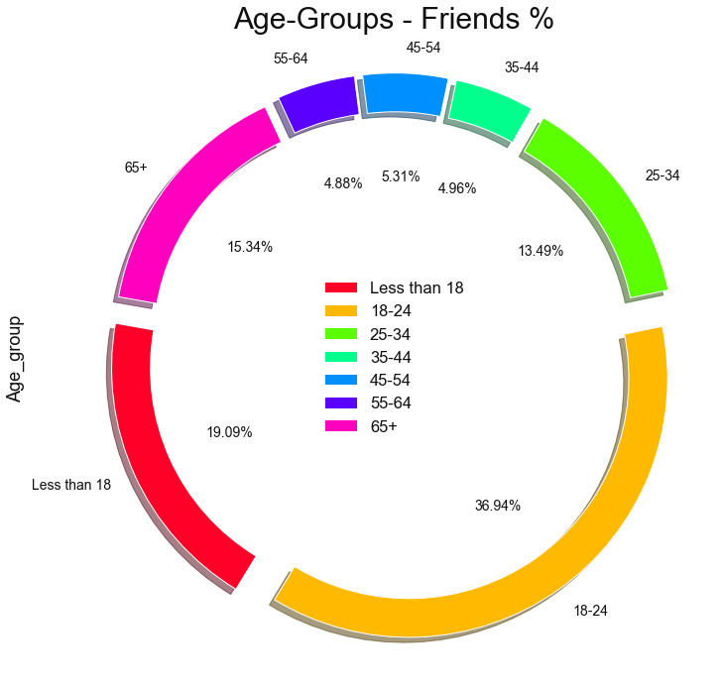
56%
Less than 18
18-24
Notes:
Analysis of Friend % across different age groups reveals that 18-24 Age group has the highest no. of friends around 37%, followed by Less than 18 age group with 19% and both groups collectively have 56% of entire population.

Slide 16
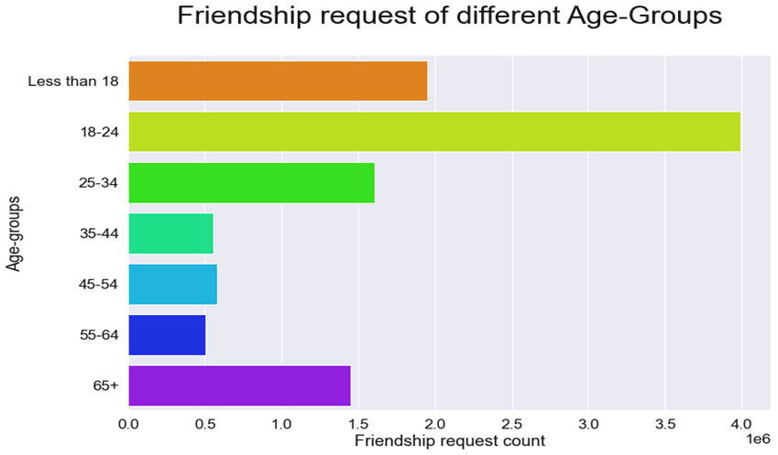
Notes:
Then Analysis of Friendship request of different age groups reveals that 18-24 age group has initiated the highest no. of friend’s request

Slide 17
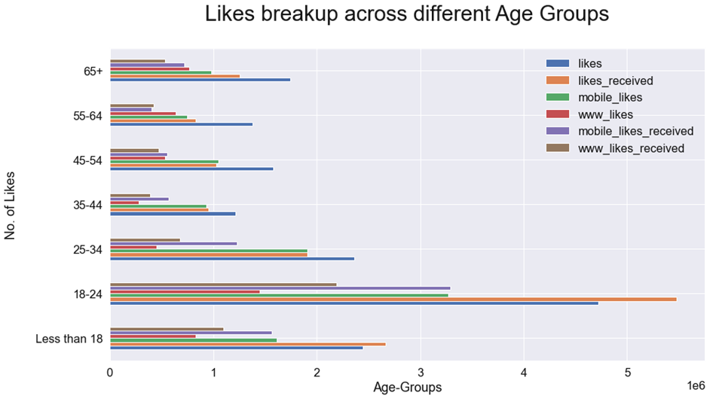
Next
Notes:
Analysis of the likes across all age group reveals that age group 18-24 is the most active age group in likes across mobile and web platforms .

Slide 18


Slide 19
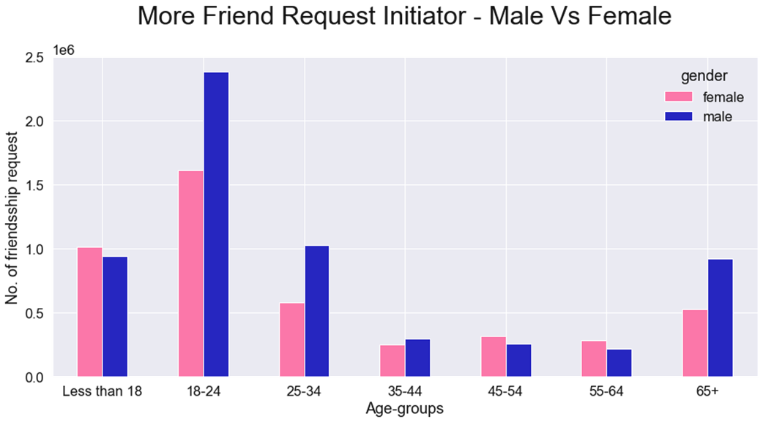
Notes:
Here Analysis of Who is initiating more friend request – Male or Female ? reveals that Maximum friend request are initiated by Males in the Age Group of 18-24, Followed by age groups less than 18 and 25-34

Slide 20
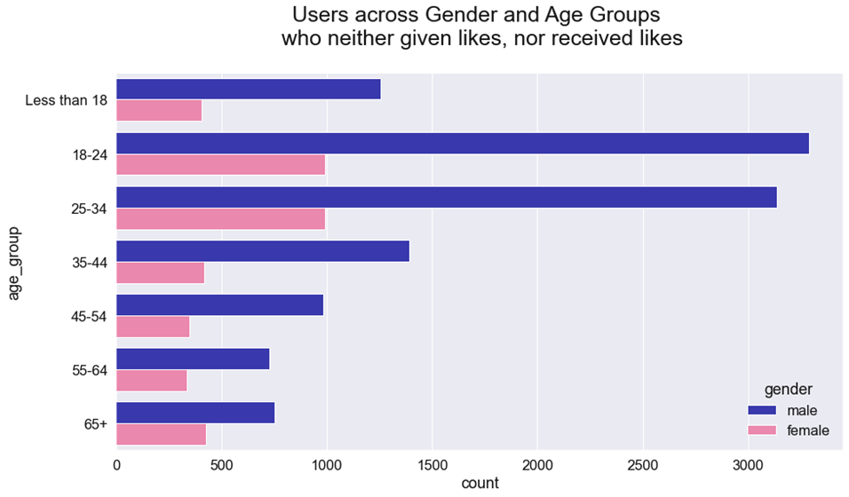
15.6%
Notes:
Now shift Analysis focus towards passive users who neither given like nor received likes and that analysis reveals that there are 15.6% such users

Slide 21
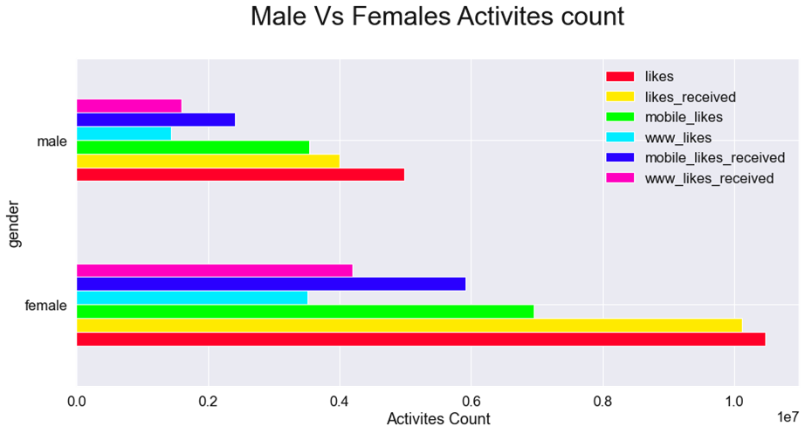
Notes:
Analysis of Female Vs Males Activities count reveals that Females are more active users across all web and mobile platforms.

Slide 22
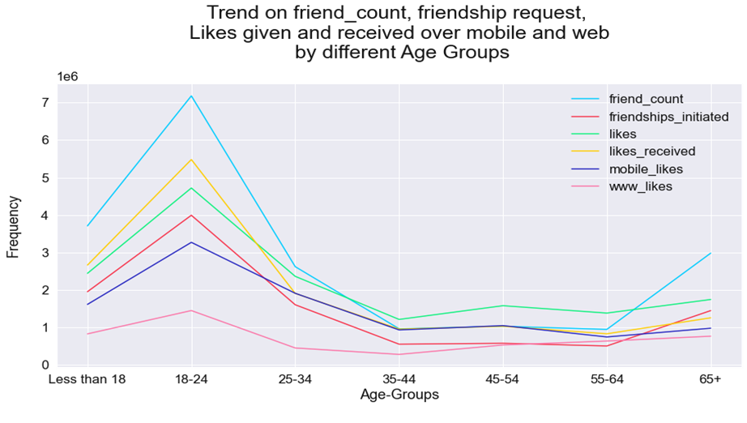
Next
Notes:
Then Trend analysis of friend count, friendship request and Likes reveals that 18-24 is the most active age group and there is decline in user interest from age 25 onwards and that’s get flatten after age 35

Slide 23


Slide 24
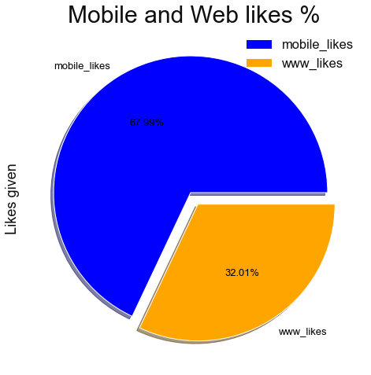
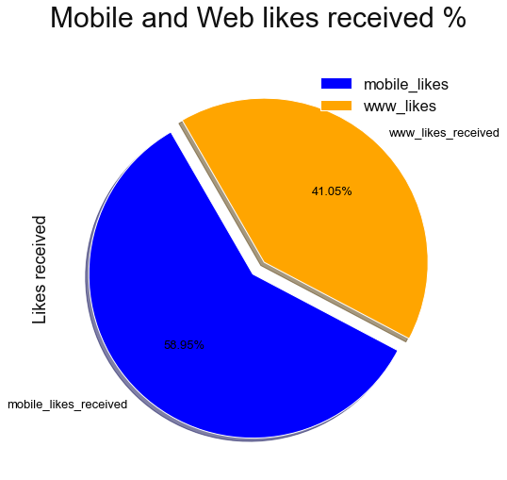
Notes:
Here analysis of Likes given and likes received across mobile and web shows the higher mobile % across both that’s proved mobile is the most preferred medium by facebook users.

Slide 25
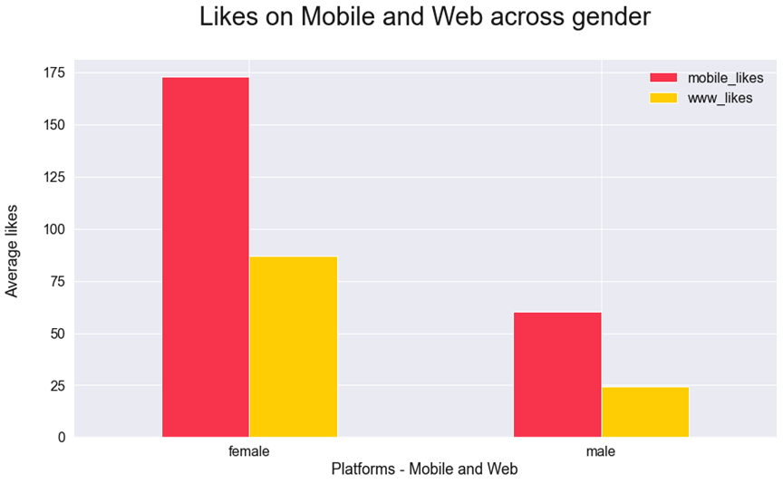
Notes:
Then next analysis of likes by gender across mobile and web reveals that female are leading both platforms.

Slide 26
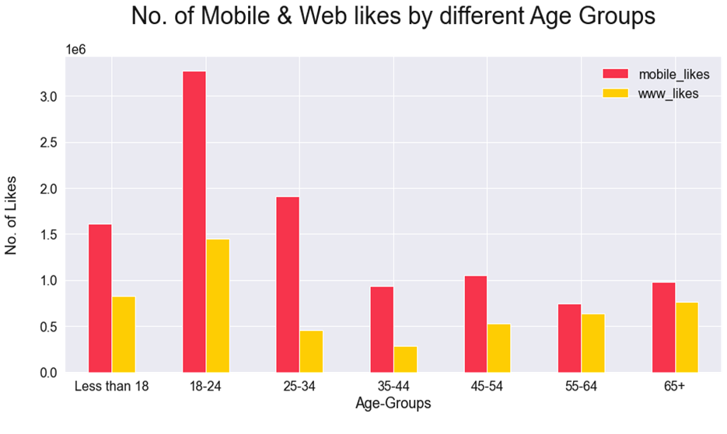
Next
Notes:
And analysis of likes across mobile and web by different age groups reveals that 18-24 age group leading both platforms.

Slide 27
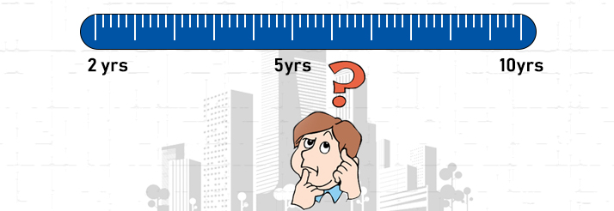

Slide 28
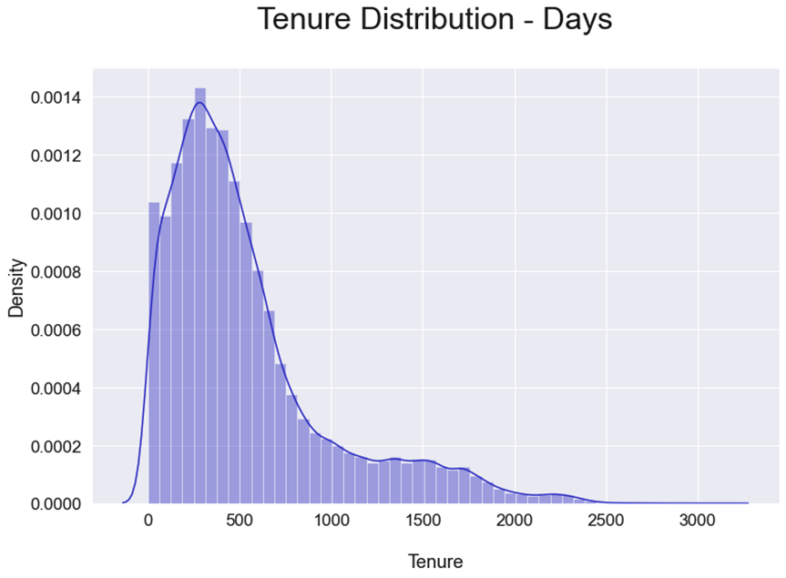
Notes:
Tenure distribution analysis in days and years reveals that

Slide 29
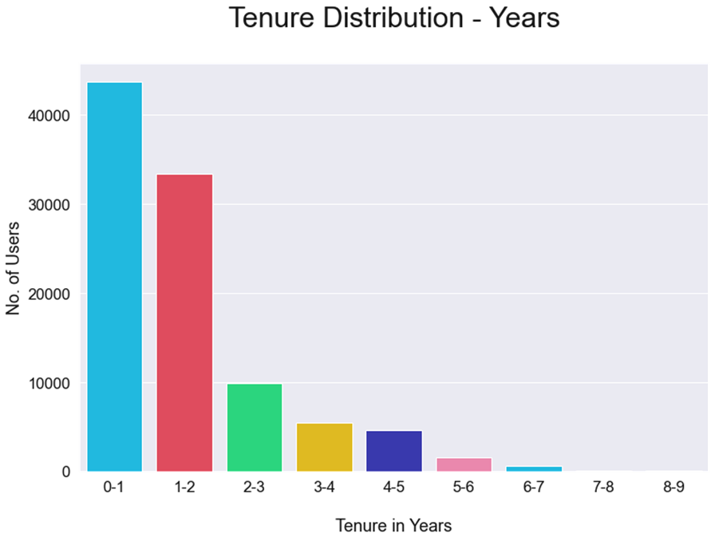
Notes:
Highest peek of tenure is in 1st year and majority of users tenure seems around first 2 years
Higher count of users in first 2 years indicates that most of the new users joined in these 2 years period.

Slide 30
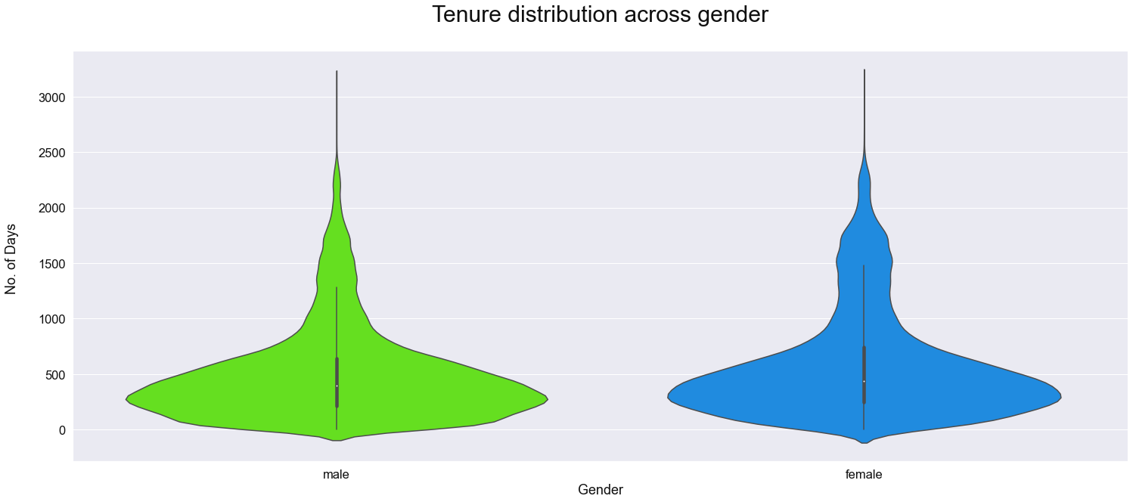
Notes:
Then analysis of Tenure distribution across gender reveals that here is no much difference in tenure as both are concentrated around the same time frame.

Slide 31
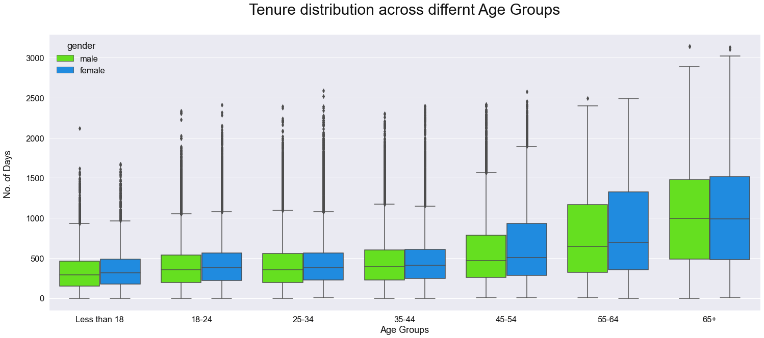
Notes:
Then analysis of Tenure distribution across different age groups reveals that Tenure is high for higher age groups in comparison of younger ones and Male and Female tenure are similar across different age groups

Slide 32


Conclusion
User
Demographic
Activity
Platform
Tenure
1
2
3
4
5
v
All age groups
13 - 113
Most Active Users: Female
Maximum users Tenure is less than 1 Year
Maximum users:
18-24 (27.5%), followed by 25-34 (21.3%) Age group
Mobile is the preferred choice of users
by both gender – Male and Female
Across all age group as compare to Web
M:F Ratio 60:40
Trend - Decline User Interest from Age 25 onwards and get flatten after age 35
Most of the new users joined in 1 year period
Female Average friend count is higher than male 60:40
Total users of these 2 groups: 49%
Average Tenure across majority of age groups is less than 2 Years.
Males 14% ahead in friendship request initiation
Most Active age group: 18-24
15.6% Passive user counts
Notes:
Now, summarizing our conclusion and final recommendation.
Here are the Conclusion based on Facebook Users, Demographics, User Activities, Platform and Tenure.
For the User:
Facebook is used by all age groups from Age 13 onwards and upto 113 but quite popular among Teenage and Youngsters.
Facebook users are 60% male and 40% female.
Female average friend count is higher than Males (60:40), however Males are 14% ahead in friendship request initiation in comparison to females.
Demographics
Maximum users on Facebook are age group 18-24 (27.5%) , followed by age group 25-34 (21.3%) .
Total users % of these 2 groups are around 49% which proves that majority % of facebook users are young
Most Active age group is 18-24 across all activities and platforms
Activity:
Females are more Active facebook user as compare to Males
Trends show most active user groups is 18-24 and trend shows decline in user interest from age 25 onwards and that’s get flatten after age 35
Passive user counts are around 15.6%
Platform
Mobile is the preferred choice of facebook users by both Male and Female and across all age groups as compare to Web.
Tenure
Maximum facebook users tenure is less than 1 Year which indicates that most of the new users joined in 1 year period. And average tenure across majority of age groups is less than 2 Years.

Slide 33

Actionable Insight
Focus
On
Strategies and Programs
User Experience
v
Males
Enhance user experience by making existing features more simpler
Make Mobile platform more User friendly
Keep adding new features for masses
Age 25 onwards
15.6% Passive users
Leverage Top 10 facebook Users
Target Youth to increase user base and retention
Design more Programs and Services for
Females
Basis above insights, Facebook may focus on specific areas mentioned here, depending on their priorities.
Notes:
Focus on Males to increase their engagement rate in facebook activities.
Focus on designing more Programs and Services for Females as they are the most active facebook users.
Make specific Strategies and Programs for:
Age 25 onwards to increase their engagement on facebook activities.
15.6% Passive users to convert them into Active ones.
Top 10 facebook users to leverage facebook programs and campaigns as they can play an impactful Influencer role.
Youth to increase their user base, their engagement and to retain them actively on facebook for longer duration.
Enhance user experience by making Mobile platform more User friendly to Target every age group users and keep adding new feature being a preferred platform by facebook users.

Slide 34
Thank You!
Notes:
Hope this was an insightful session and recommendation helps to achieve the objectives.
Thank you and have a great day !!

